Slide 1
Assuring cross-border payments in Africa

Slide 2
FATF Recommendation 16
Designed to stop the use of “wire” payments to fund:
Fraud
Money laundering
Terrorism financing
Proliferation financing
Wire payments are simply electronic payments: they don’t need to be between accounts at different institutions.
“Specifically, it aims to ensure that basic information on the originator and beneficiary of wire transfers is immediately available” to:
Law enforcement authorities – to trace funds and investigate crimes
Financial intelligence units – to analyse and publicise suspicious activity
Participants in the payment – to deny criminals and terrorists access to the payments system
It is designed to answer the question: “who is paying whom?”

Slide 3
Who can answer this question?
First and foremost: the institution(s) which hold the accounts.
In a wire payment, it is safe to assume that the sending institution knows whose account it is sending from.
Regulation will ensure that a sending institution will ensure:
That an account has been opened with verification of the holder’s identity.
That a payment is within the rules specified for a given type of institution or account.
So the question is: how does the receiving institution find out which account to credit?
In the economies of the West, people are used to the idea of account numbers.
But if your account is with a credit union, or a mobile money system, or a Micro-Finance Initiative…
… so Mojaloop uses identifiers.

Slide 4
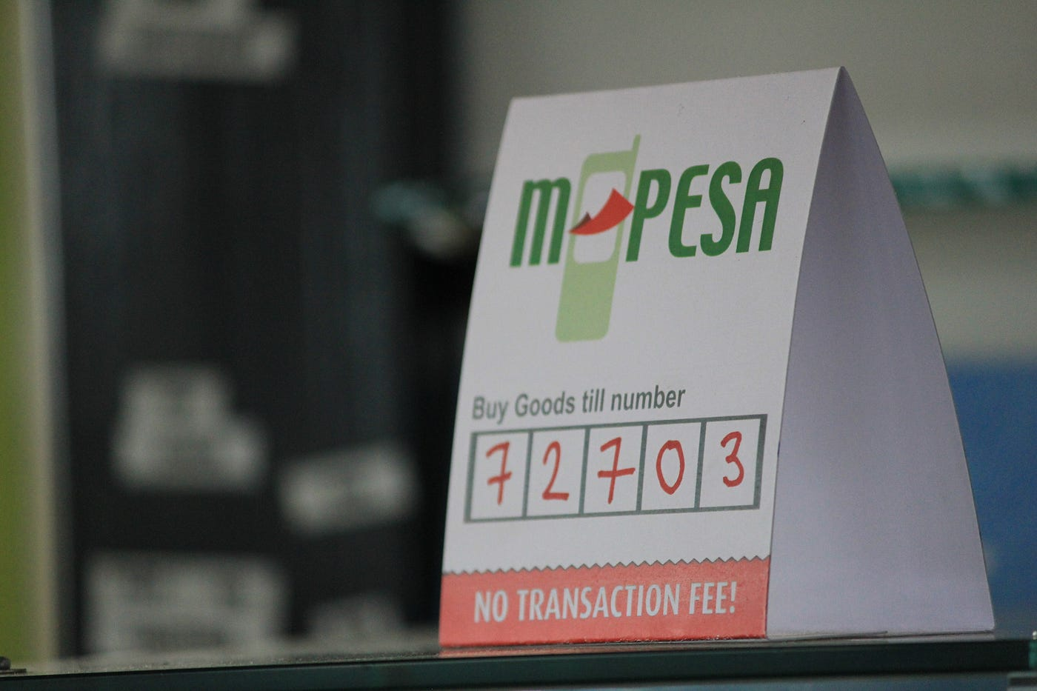
Identifiers
An identifier is something that the sending party knows about the beneficiary…
… and the beneficiary’s DFSP registers with the Mojaloop system.
When the sending party wants to pay the beneficiary:
They look for the beneficiary using an identifier.
The Mojaloop system scans the registry of identifiers.
It forwards the request to the registered DFSP.
The DFSP uses the identifier to identify its customer…
… and returns the customer’s “name” as confirmation.
The customer’s account number is never used in the payment
FATF Recommendation 16 says that a unique transaction identifier is sufficient if an account number is not used to process the payment.

Slide 5
Customer warranty in the agreement of terms
The sending institution:
Warrants that its customer can legitimately make the payment (otherwise it would not issue the request).
Provides an external mechanism by which the receiving institution can identify the entity who should be credited.
The receiving institution:
Warrants that its customer can legitimately receive the payment.
It does this by agreeing to the terms of a payment.
So now:
The receiving institution knows that the sending institution warrants that its customer can legitimately make the payment.
The sending institution knows that the receiving institution warrants that its customer can legitimately receive the payment.
Everything else is PII

Slide 6
Personal Identifying Information
“‘Personal data’ means any information relating to an identified or identifiable natural person (‘data subject’); an identifiable natural person is one who can be identified, directly or indirectly, in particular by reference to an identifier such as a name, an identification number, location data, an online identifier or to one or more factors specific to the physical, physiological, genetic, mental, economic, cultural or social identity of that natural person.”
There must be enough information to identify a person.
We want to ensure that small, informal account-holding institutions do not need to meet the same rigorous protection standards as international banks.
We want to avoid holding personal identifying information about people

Slide 7
Current FATF recommendation
For the originator:
Their name.
Their account number, if it is used to process a payment.
Either:
Their address
Their national identity number
Their date and place of birth
A customer identification number
For the beneficiary:
Their name.
Their account number, if it is used to process a payment.
The definition of a customer identification number:
“a number which uniquely identifies the originator to the originating financial institution and is a different number from the unique transaction reference number referred to in paragraph 7. The customer identification number must refer to a record held by the originating financial institution which contains at least one of the following: the customer address, a national identity number, or a date and place of birth.”
It is a reference which can subsequently be converted into information.

Slide 8
Reducing PII
The more PII a system holds:
The more attractive it is to bad actors.
The more security is required to protect it.
The trade-off:
Immediate availability of information on the parties to every transaction, against
Two-step identification where needed.

Slide 9
Our proposal for cross-border payments
Regulators trust that their opposite numbers are properly regulating their DFSPs.
Each DFSP participating in a payment is responsible for assessing whether its customer can legitimately make or receive a payment.
Each payment has a globally unique identifier.
Each payment contains a reference number for each of the parties.
The reference number can be used by institutions with a legitimate interest to retrieve information about party from the institution which holds the party’s account.

Slide 10
However…
Proposed changes to Recommendation 16 would:
Remove the customer reference number
Require an address.
Require a date of birth, even where that was not verified.
Rely on a de minimis exemption implemented by individual jurisdictions to lighten the burden on institutions serving the poor.

Slide 11
Discussion

